Slide 1
The land restoration fund
Tom Webster
Manager, Natural Capital Program
Department of Environment and Science

Slide 2
The carbon market in Australia
Changes in the carbon market mean opportunity for landholders to diversify their businesses and be part of climate action
Price of carbon credits is trending upwards over the long term
Demand for carbon credits is predicted to increase by a factor of 15 or more by 2030 and by a factor of up to 100 by 2050
By 2030, the carbon market could be worth up to $50bn

Slide 3
Structure and Outcomes
The Land Restoration Fund
Structure
Co-benefits
Environmental
Socio-economic
First Nations
The Land Restoration Fund
Commercial
LRF Trust
Invest in projects that deliver carbon credits + co-benefits
Industry Development
Invest in research, innovation and capacity building to grow the market
Verified by LRF Co-benefits Standard

Slide 4
LRF vs. ERF
 | Land Restoration Fund (State) | Emissions Reduction Fund (Federal)
Purchases ACCUs | YES | YES
Pays for co-benefits in addition to carbon | YES | NO
Projects must register with the ERF | YES | YES
Purchasing method | Contracting for ACCUs and co-benefits through dedicated investment rounds | Contract for lowest-cost ACCUs through reverse auctions

Slide 5
What are co-benefits?
Co-benefits are the additional positive environmental, socio-economic and First Nations outcomes delivered by carbon farming projects.
The Land Restoration Fund (LRF) invests in Queensland carbon farming projects that:
a) generate Australian Carbon Credit Units (ACCUs), and
b) generate environmental, socio-economic or First Nations co-benefits as defined in the LRF Co-benefits Standard.

Slide 6
The Financial Value of Co-Benefits
Claiming co-benefits adds an extra revenue stream to carbon farming projects, making possible projects that may otherwise not be financially feasible
Break even line

Slide 7
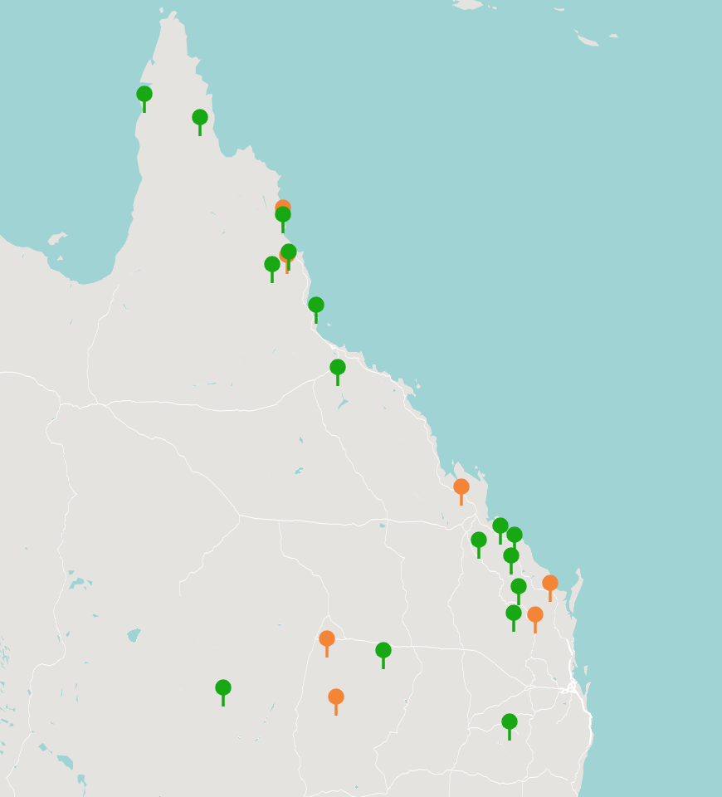
Land Restoration Fund projects
Round 1- launched 2020
16 projects contracted
$87.7 m committed
1.7m ACCUs contracted over 15 years
1.7m tonnes of carbon dioxide sequestered or avoided
357,000ha of Category X land set aside for carbon farming
Co-benefits – Top 4
Employment and skills: 15 projects
Threatened ecosystems: 14 projects
Native vegetation: 13 projects
Threatened wildlife: 12 projects
Round 2 - launched 2021
6 projects contracted
$12.84 m committed
131,026 ACCUs contracted over 16 years
131,026 tonnes of carbon dioxide sequestered or avoided
6,927 ha of Category X land set aside for carbon farming
Co-benefits – Top 4
Threatened ecosystems: 5 projects
Employment and skills: 5 projects
Native vegetation: 6 projects
Threatened wildlife: 6 projects

Slide 8
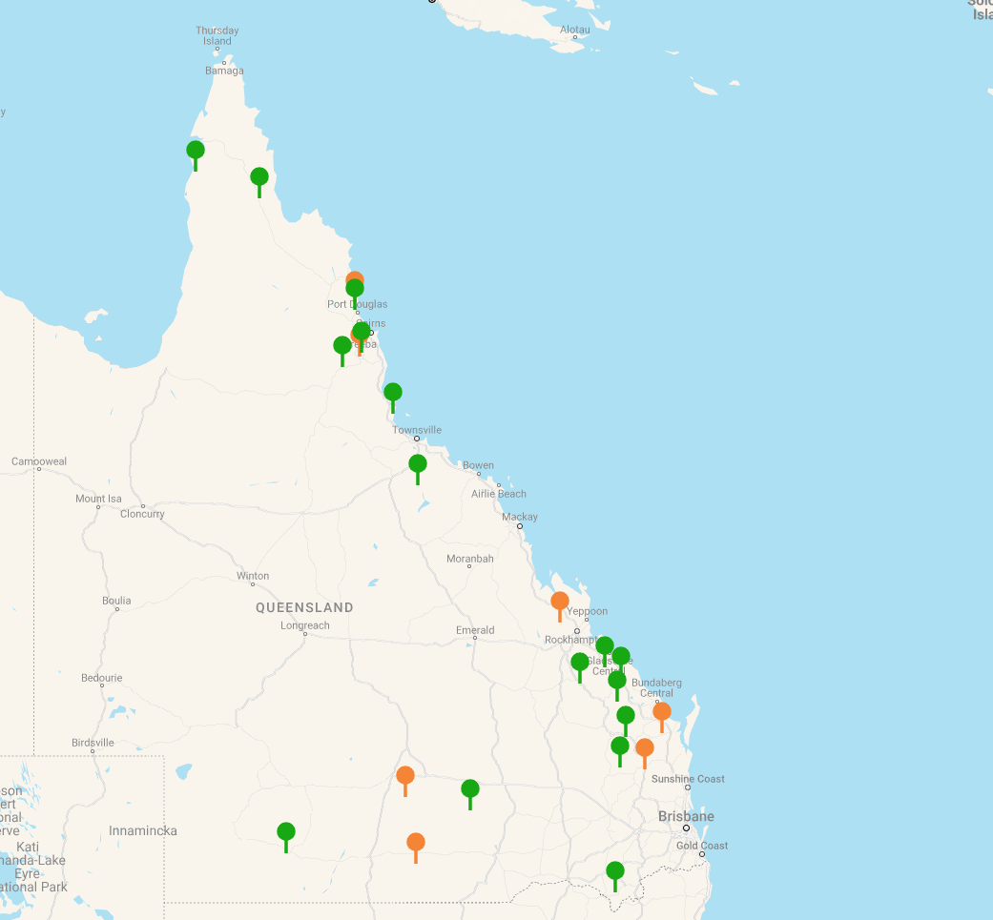
Wide Bay Burnett Cluster - 9 projects
Co-benefits Legend | 25 x Threatened ecosystems/wildlife or Native Veg 16 x Socio-Economic 15 x Great Barrier Reef/Coastal Ecosystem 3 x Soil Health 3 x First Nations
Project | Number of Co-benefit classes |  |  |  |  |  |  |  |  |  | Total
R1034 |  |  |  |  |  |  |  |  |  |  | 5
R1038 |  |  |  |  |  |  |  |  |  |  | 7
R1040 |  |  |  |  |  |  |  |  |  |  | 10
R1054 |  |  |  |  |  |  |  |  |  |  | 8
R1062 |  |  |  |  |  |  |  |  |  |  | 7
R1063 |  |  |  |  |  |  |  |  |  |  | 6
R2023 |  |  |  |  |  |  |  |  |  |  | 7
R2025 |  |  |  |  |  |  |  |  |  |  | 8
R2029 |  |  |  |  |  |  |  |  |  |  | 4
R2025
R1034
R1063
R1054
R1040
R1038
R2029
R2023
R1062

Slide 9
Is carbon farming right for your business?
Making the most of that opportunity requires planning to make sure:
That carbon farming is right for your business or organisation
That you can develop and deliver a project that makes the most of your land and resources and achieves your project objectives, whether that be generating and selling carbon credits; managing your emissions; improving the environment or all of the above
Check eligibility to register with the Emissions Reduction Fund Search ‘Emissions Reduction Fund questionnaire’
Assess you land for potential to store carbon and generate co-benefits CSIRO calculator: https://looc-c.farm/ AgriFutures tool: https://agrifutures.com.au/news/new-online-tool-to-unlock-carbon-curiosity/
Seek advice from a Carbon Service Provider, local NRM Regions representative or Land Restoration Fund Approved Adviser Find an Approved Adviser: https://www.qrida.qld.gov.au/program/approved-advisers-program-under-carbon-farming-advice-rebate-program

Slide 10
www.qld.gov.au/landrestorationfund
THE LAND RESTORATION FUND

