Slide 1
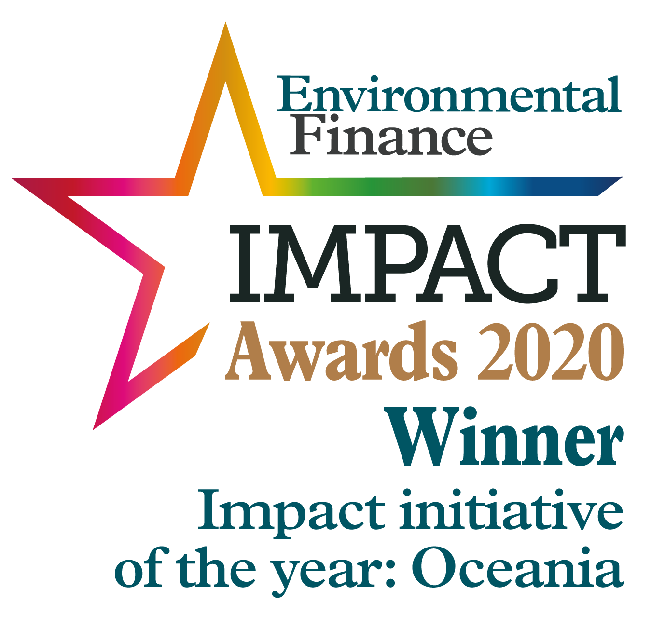
Building the world’s most scientifically credible environmental accounting standard.
Opening new markets for natural capital.

Slide 2
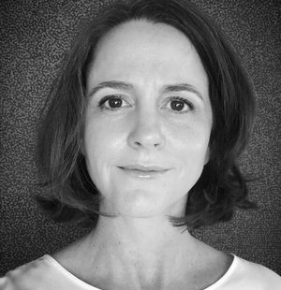
Who are we
ANNIE KELEHER - Certification Program Manager has 20 years’ of experience across private industry and research, delivering on project management at various scales, workshop facilitation and the design and delivery of technical training material. She holds a Master in Environmental Management and is motivated to create sustainable solutions that enable a balance between the environmental, economic and social demands on land use.
Dr AMANDA HANSSON (Project Manager – Capacity building & Advisory) has more than nine years of experience in environmental research, natural resource management and the creation and delivery of educational material. She has project management experience in both the private and public sectors and has provided consultancy services on national emission reduction projects. At Accounting for Nature, Amanda works directly with Landcare, producer groups, natural resource management bodies and other organisations to originate Environmental Accounts at the project to regional scale.

Slide 3
Objectives of this session
Introduction to the Accounting for Nature® Framework
AfN Environmental Account Certification process
AfN Accredited Experts
How are Methods implemented in the field?
AfN Accredited Methods

Slide 4
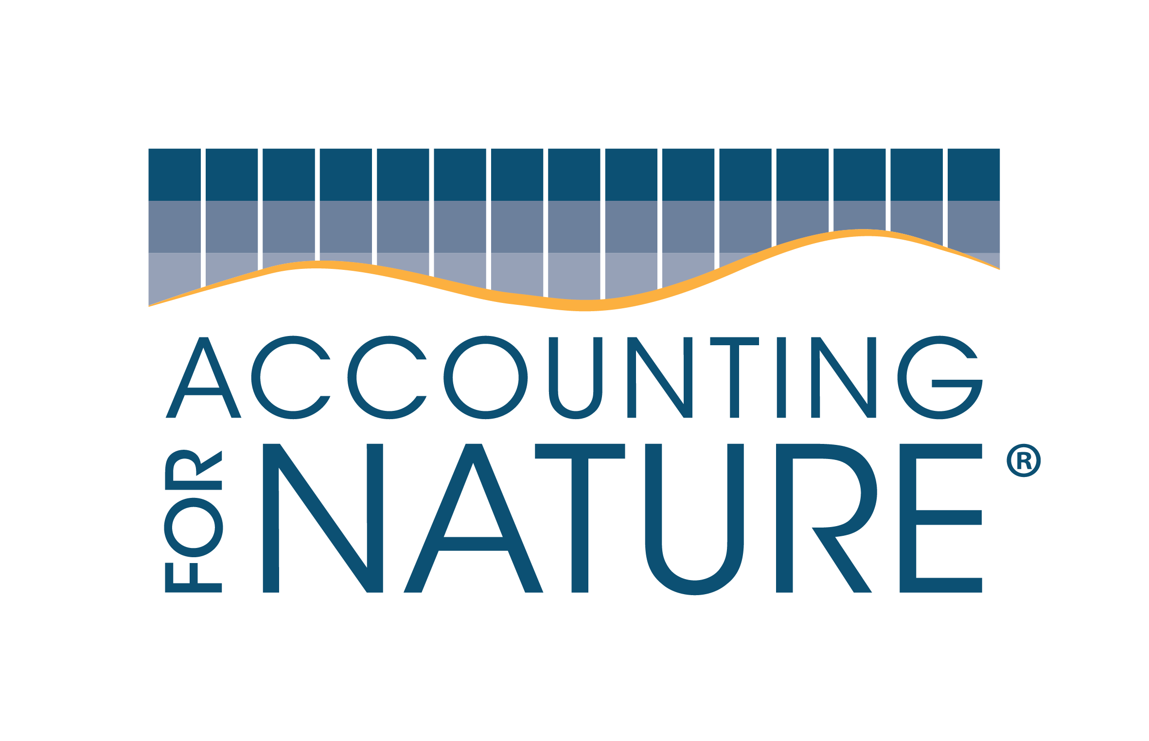
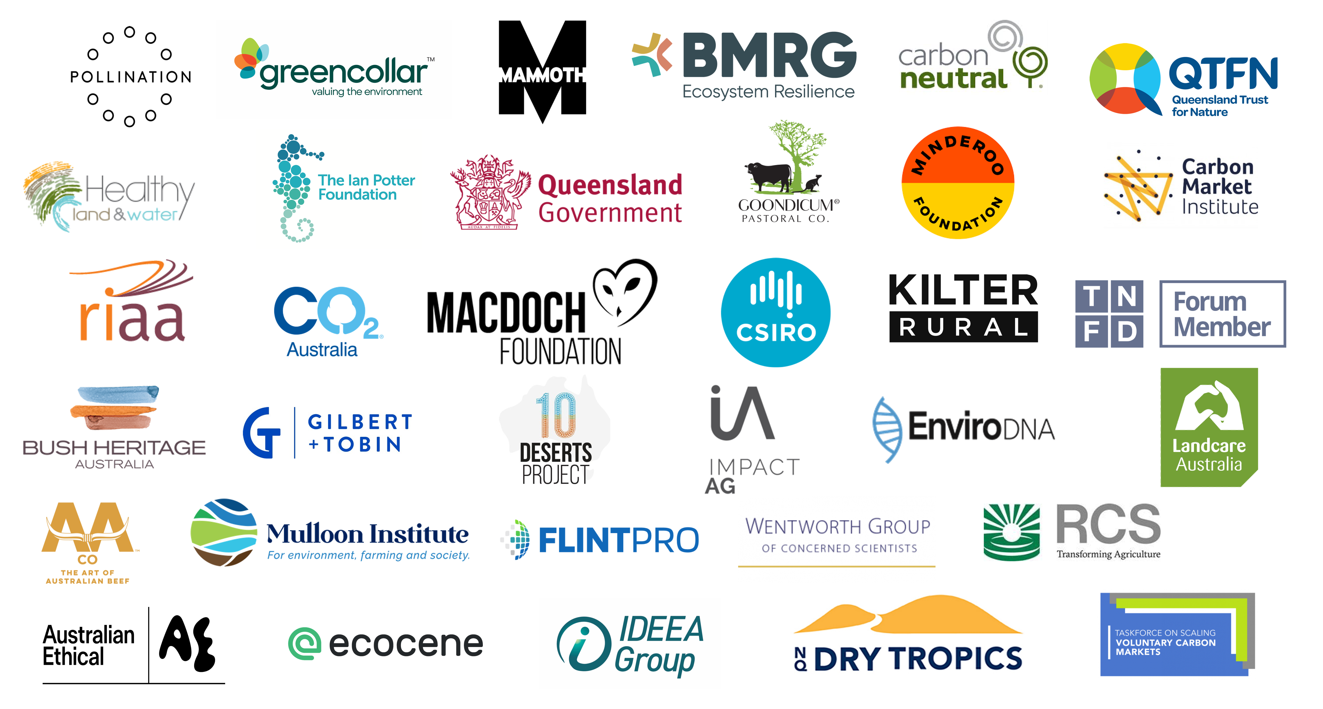
Collaborators
Not for general distribution

Slide 5
Nature-risk disclosure.
Soon to be the new norm in corporate transparency.
Disclosure of “nature risk” in a company’s supply chain or investment portfolio is becoming the norm – just like was the case for climate change in the last few years.
This is demonstrated by the recent and strong interest in the taskforce for Nature-related Financial Disclosure (TNFD).
Accounting for Nature® environmental accounts, fit neatly into the TNFD’s LEAP approach.
AfN was recognised by the TNFD in Section 9.3.4 of Annex 1: Guidance on Metrics for the Evaluate Phase of LEAP as a framework for Environmental Accounting that requires the actual condition of environmental assets.

Slide 6
The global challenge
It is not possible to build a sustainable economy without measuring the change in environmental condition.
Governments, investors and consumers need simple yet scientifically credible environmental metrics to make informed decisions.
Solving this global challenge changes the way we manage the economy and unlock billions of dollars for environmentally sustainable Investments.

Slide 7
Our solution
Accounting for Nature® is a global environmental accounting framework.
It’s designed to guide business, investors, governments and landholders in building scientifically credible environmental accounts.
This allows for informed decisions when managing and investing in environmental assets, and when selling sustainable products and services.

Slide 8
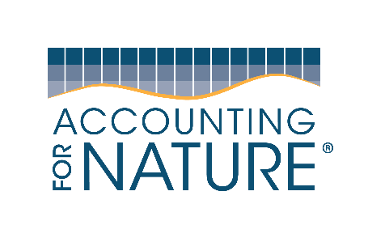
Alignment of AfN and Global Frameworks
Framework, Standard, Goals | Does AfN align?
Sustainable Development Goals | Yes
Convention on Biological Diversity | Yes
Global Goal for Nature | Yes
UN SEEA | Yes
BIOFIN | Yes
TNFD | Yes
Science Based Targets for Nature | Yes
Natural Capital Protocol | Yes
ISSB | Yes
SASB | Yes
GRI | Yes

Slide 9
What is the Econd®?
The Econd® summarises complex scientific information into a single, easy to understand metric.
Reference State
The Econd ® (Environmental Condition Index) is a common unit of measurement that allows us to:
Compare the relative condition of any environmental assets
Aggregate different types and scales of information
Econd®
0 100
The Econd® index shows a clear trend in the condition of any environmental asset over time, compared to its reference state.

Slide 10
What does AfN do?
Certification of environmental accounts in accordance with the AfN Standard.
Accreditation of Scientific Measurement & Monitoring Methods for use under the Standard.
Training & accreditation of experts & auditors through face-to-face and online training and assessment and “AfN Expert Register”.
Coaching & advice, where we connect you with AfN Experts to assist interested parties in building their own accounts.
Developing an online environmental accounting system to cost-effectively help Proponents build their own Environmental Accounts with the click of a button.

Slide 11
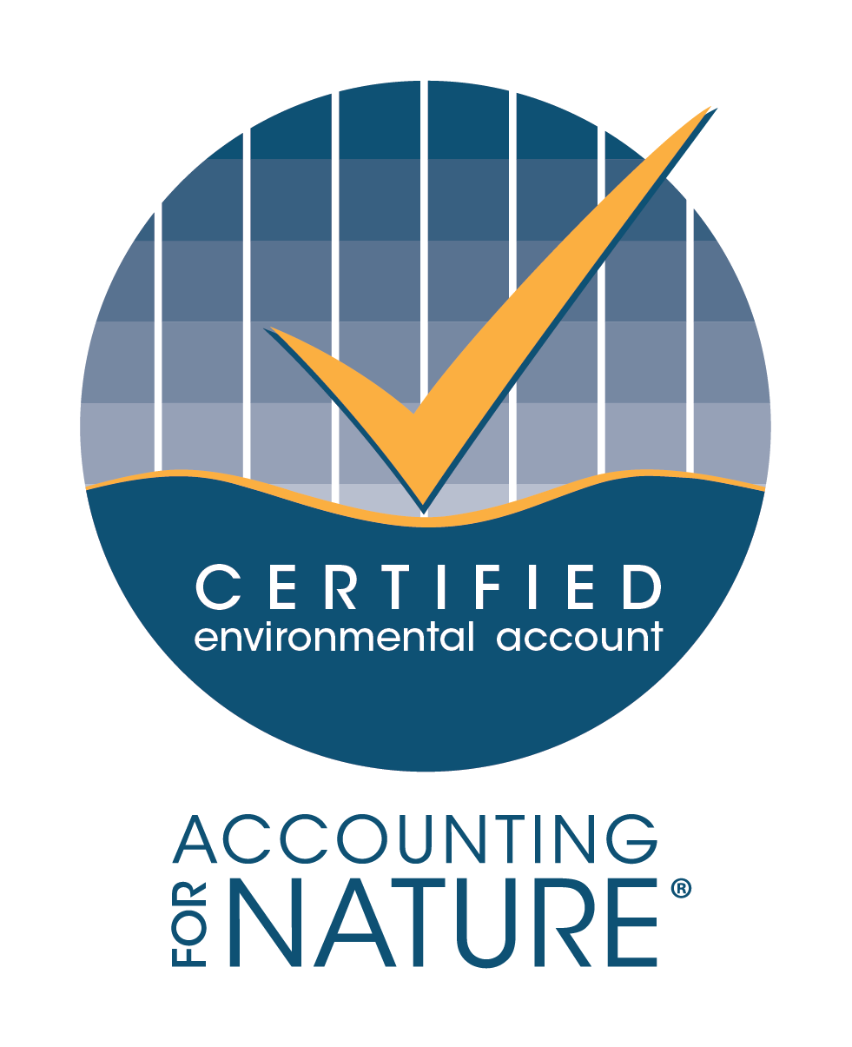
MARKETS
Landscape Green Bonds
Impact Investment for Real Assets
Corporate carbon + env co-benefits
Government policy
+
Mine site Rehab Bonds
Market indices & insurance
Healthy & productive
landscapes
Food & Fibre Green Labelling
Not for general distribution

Slide 12
Supporting Carbon & Nature Credits
Supporting the voluntary carbon-plus market
Accounting for Nature® is being used by Australia’s largest carbon offset project developers to verify environmental co-benefits, which is unlocking new markets and higher price premiums for carbon offset units that result in genuine improvements for nature.
Supporting pioneering work in standalone nature credits
Accounting for Nature® is the chosen Monitoring, Reporting & Verification Framework for a 3-year trial of Greencollar’s new NaturePlusTM Standard which will seek to issue and sell standalone nature credits.
AfN will extend licensing to other unitization standards
Accounting for Nature® is also being considered an outcomes-focused MRV framework by the World Economic Forum and to support Verra SD Vista and others (to be announced).

Slide 13
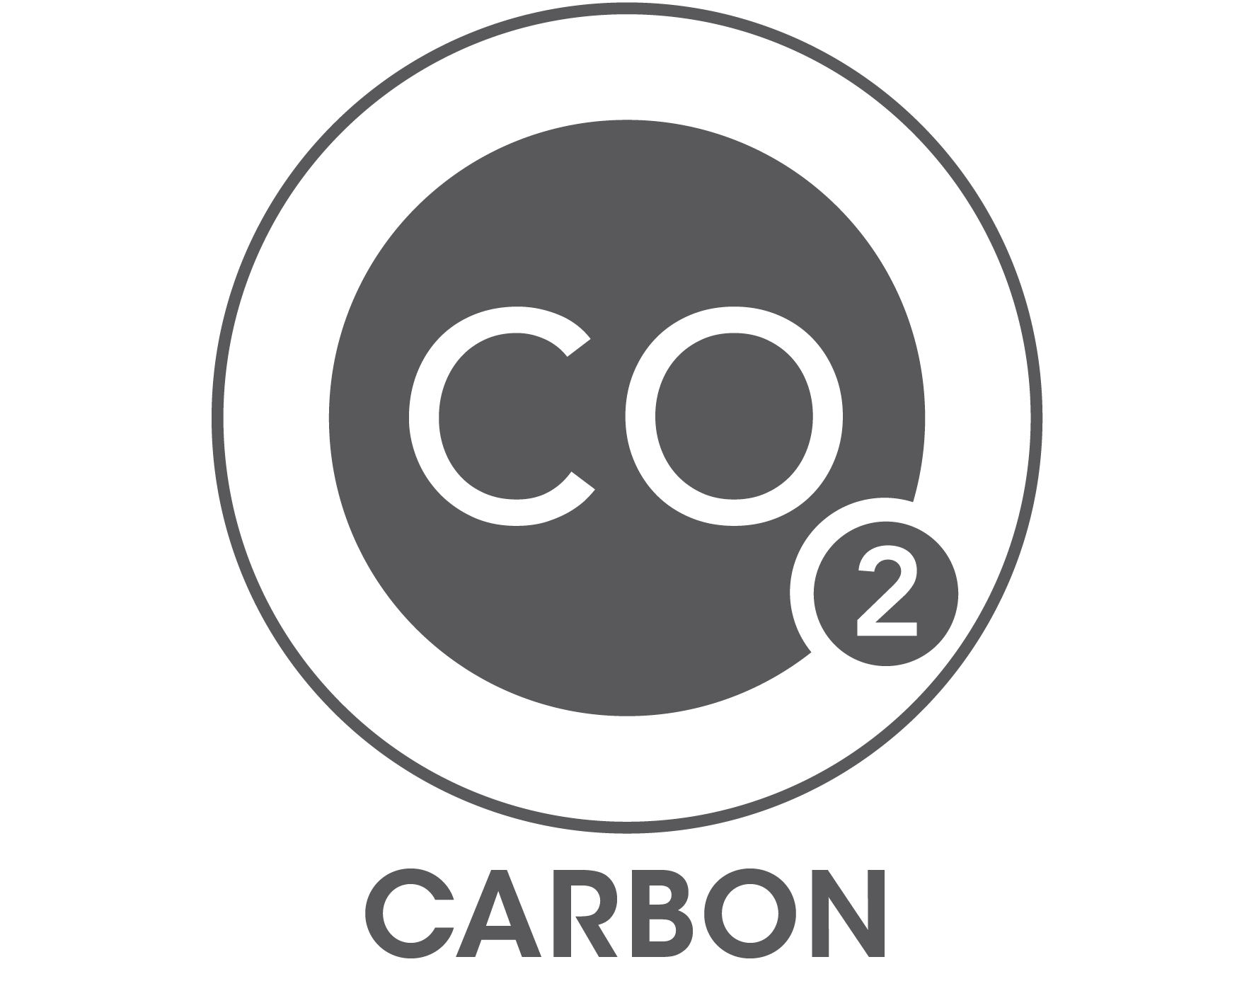
What environmental assets can you measure?
An Econd® can be generated for each of the below five environmental asset classes.
Certified Environmental Accounts can be linked with carbon or other environmental products to claim and verify environmental co-benefits.
Our Materiality Guidelines help Proponents decide what is most important to measure by:
Clearly understanding and articulating why they are wanting to develop an Environmental Account, and,
Helping to identify what the priority and significant environmental assets are that should be measured in the Environmental Account, given the account purpose, and also differing perspectives of significance

Slide 14
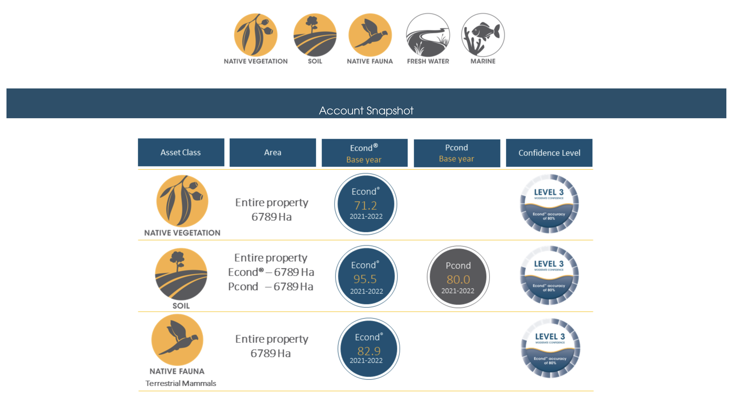
What is an Environmental Account?

Slide 15
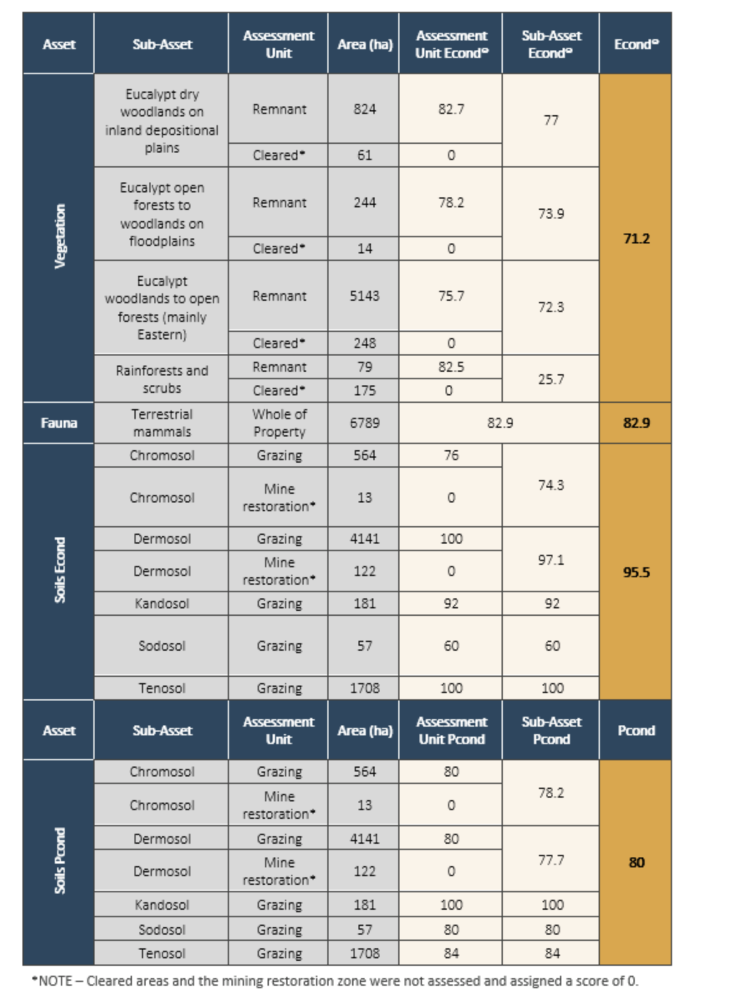
What is an Environmental Account?

Slide 16
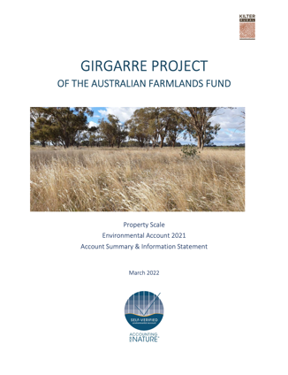
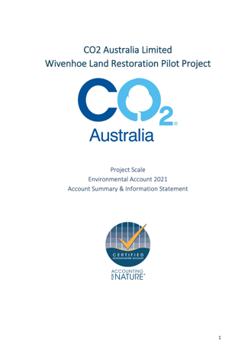
Information Statement
THE INFORMATION STATEMENT
An Information Statement is a public document that accompanies all AfN Environmental Accounts.
It includes:
An introduction to the account context, purpose and scope
A simple description of the process
A summary of the outcomes
Identification and acknowledgement of limitations
It provides complete transparency in an easy-to-understand format, which allow the market to understand exactly what was involved in creating the account.

Slide 17
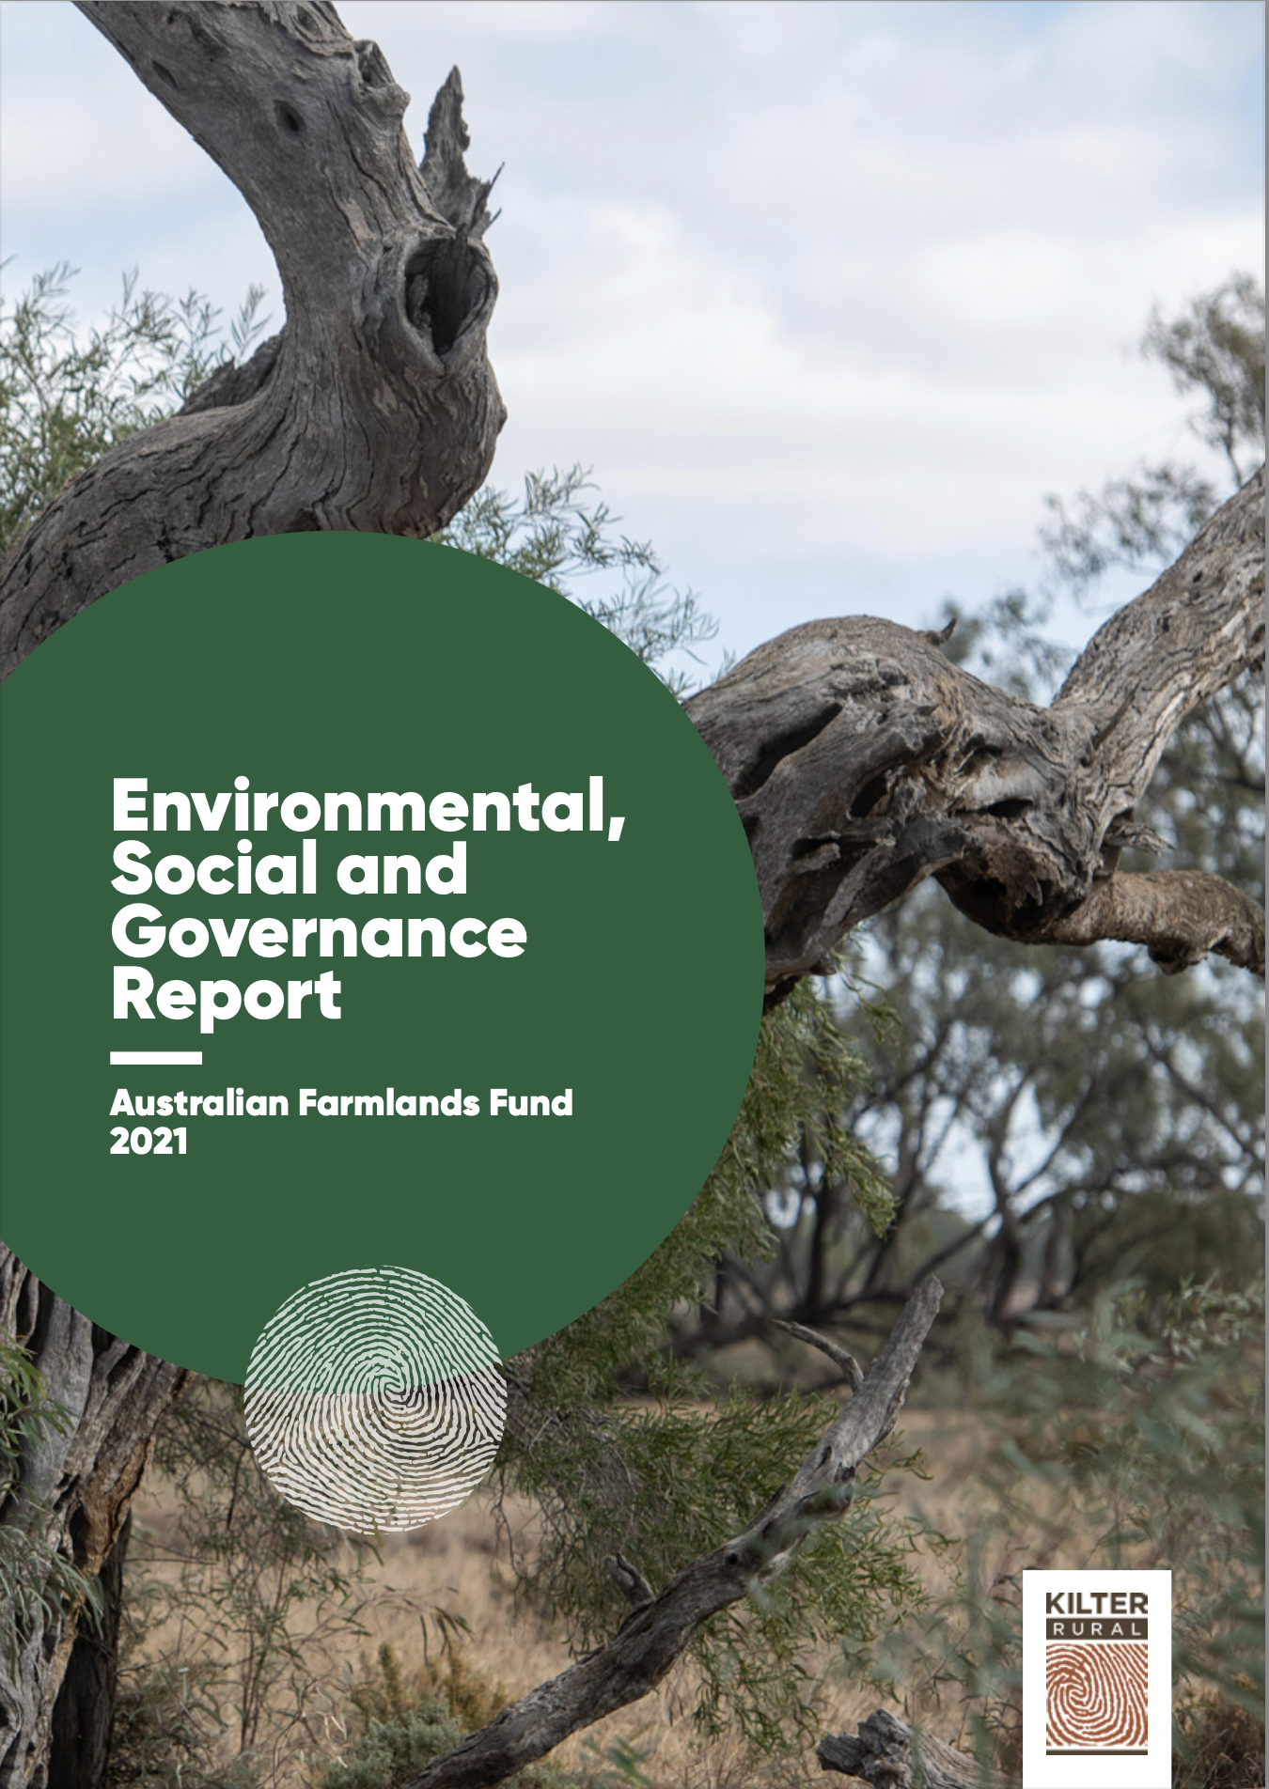
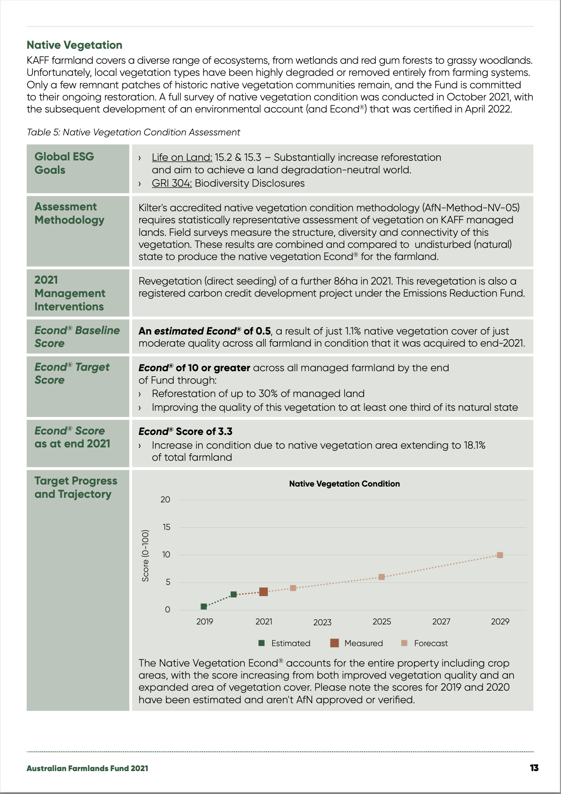
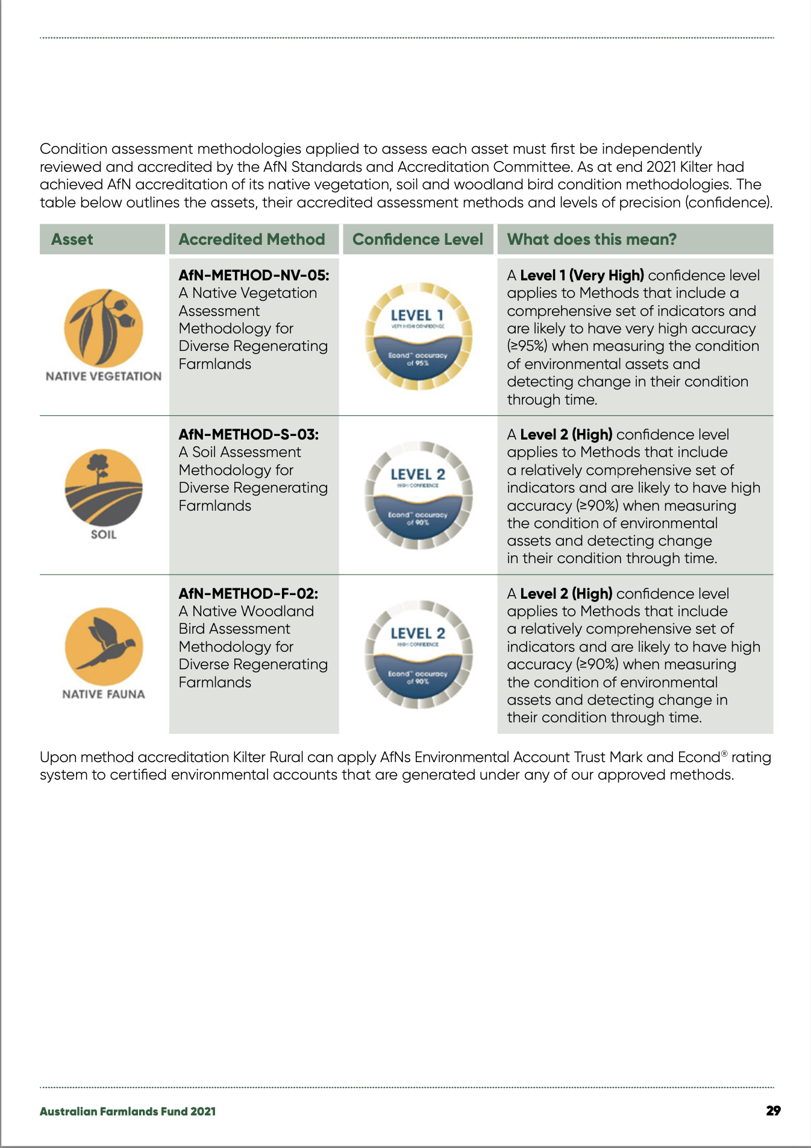
Supporting ESG reporting

Slide 18
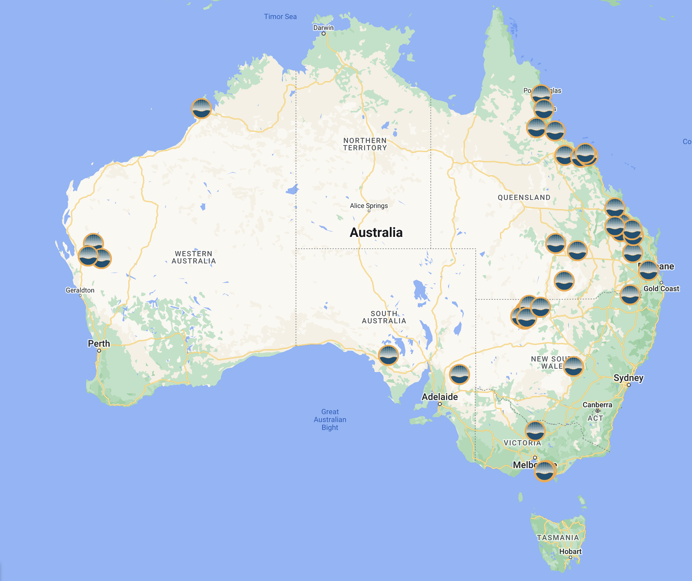
Environmental accounting projects
Currently, 47 AfN Environmental Accounting projects underway covering
+6 million ha.
Not for general distribution

Slide 19
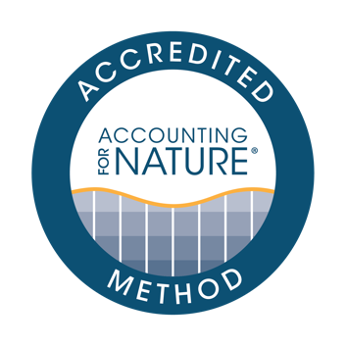
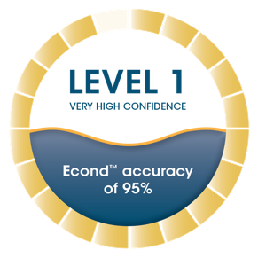
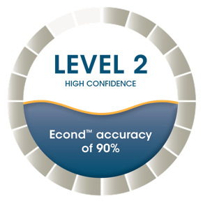
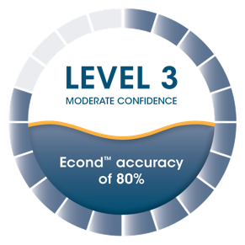
AfN ACCREDITED METHODS
AfN Accredited Methods provide the instructions on how to measure and calculate an Econd®.
Methods are developed:
For a specific purpose
For a specific environmental asset
At a particular confidence level
At a particular scale (local or regional) (regional vs local)
Method confidence levels are based on the indicators and how they are measured, and the sample size and design.
All AfN Accredited Methods must be reviewed and approved by the independent Science Accreditation Committee.
An Econd® is given the same Confidence Level as the Method used to generate it.

Slide 20
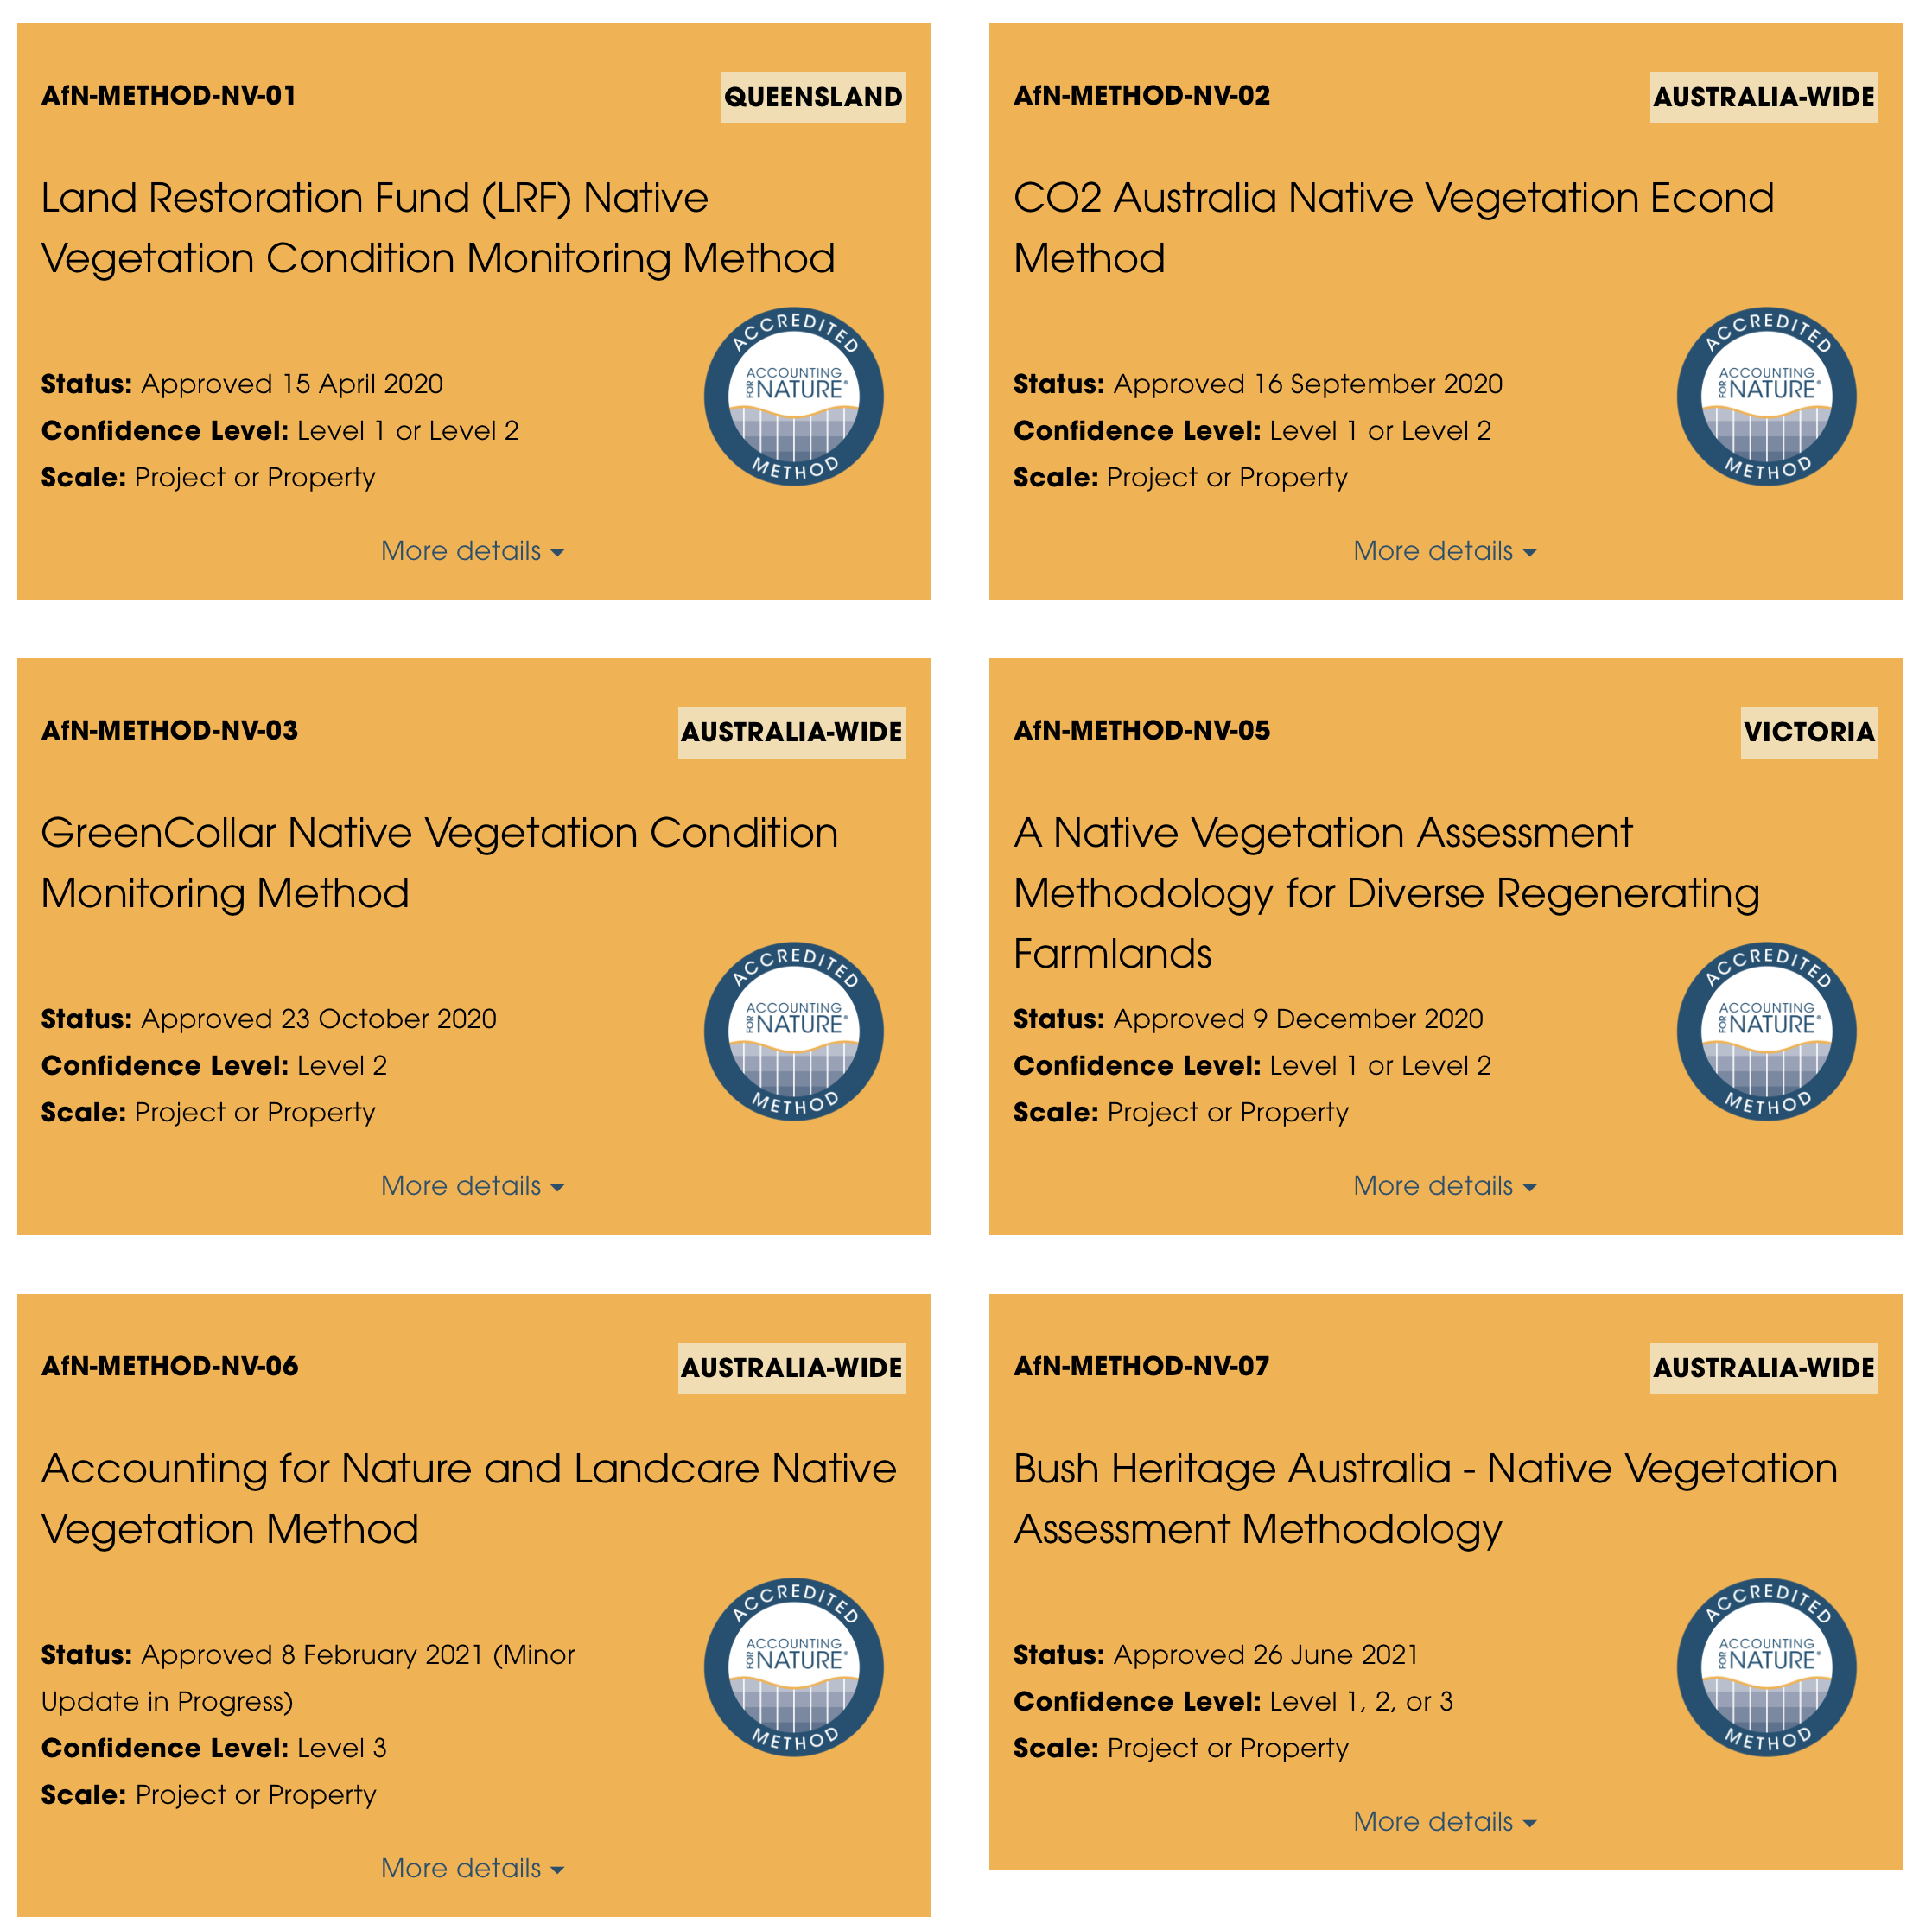
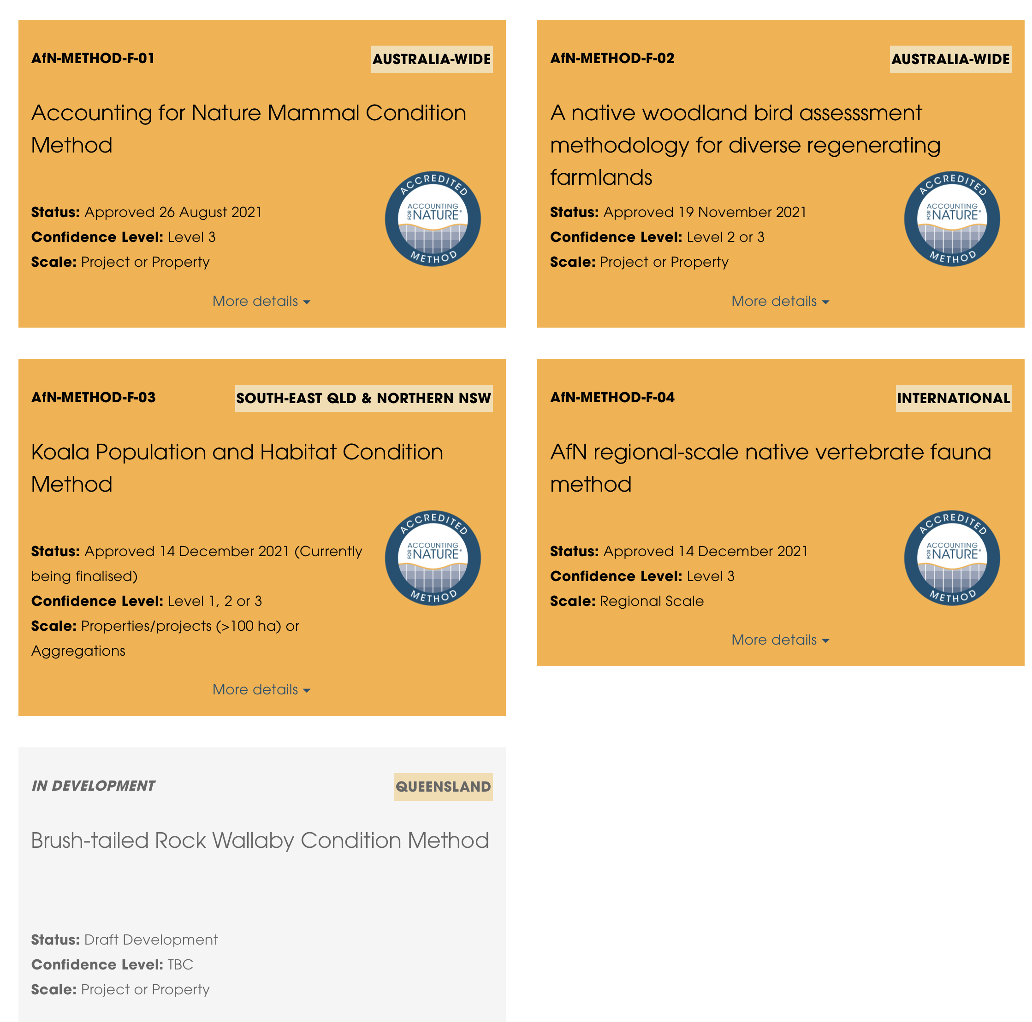
Accredited Methods

Slide 21
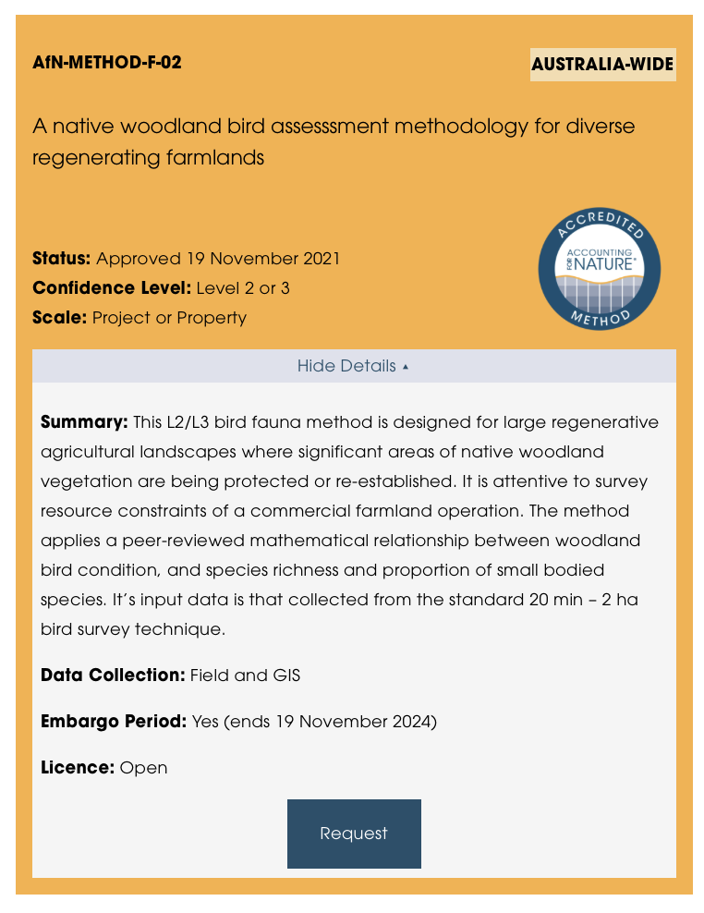
Selecting a Method – what to look for

Slide 22
Core documents and key resources
1
AfN Certification Standard
Audit & Verification Rules
Claims Rules
Fee Schedule
Glossary & Key Terms
AfN Approved Methods (discussed previously)
2
3
4
5
6
The 5-Step webpage guides you through the process of designing, building and certifying your environmental Account. This webpage provides links to download all forms, documents and other resources to help you complete this process.

Slide 23
AfN Guideline Documents
Confidence Levels Guidelines
Guidelines for Pcond soil condition accounts
Guidelines for developing Native Vegetation Methods
Provisional Bird Guidelines
Guidelines for Reference Benchmarking
Guidelines for the hindcasting environmental condition
Guidelines for setting Condition Targets
Materiality guidelines
Guidelines for Integrating Traditional Environmental Knowledge into the AfN Framework
Guidelines for counterfactual analysis
Guidelines for linking carbon offset units & the Econd®
Visual asset style guide
1
2
3
4
5
6
7
8
9
10
11
12

Slide 24
The Econd® and Pcond

Slide 25
Using Historic Data
If historic data is able to comply with an AfN Accredited Method
Calculate an Econd® and include it in the Certified Environmental Account
If historic data is not able to comply with an AfN Accredited Method
Use the information to provide some general context and background for the Account

Slide 26
Condition Targets
Describes the realistically attainable condition for a given asset
The ‘target condition’ might be the same as reference condition where the goal is to fully restore an asset to its original condition (for example in a nature reserve).
However, in the vast majority of Accounts, the target condition will be less than the reference condition, sometimes significantly.

Slide 27
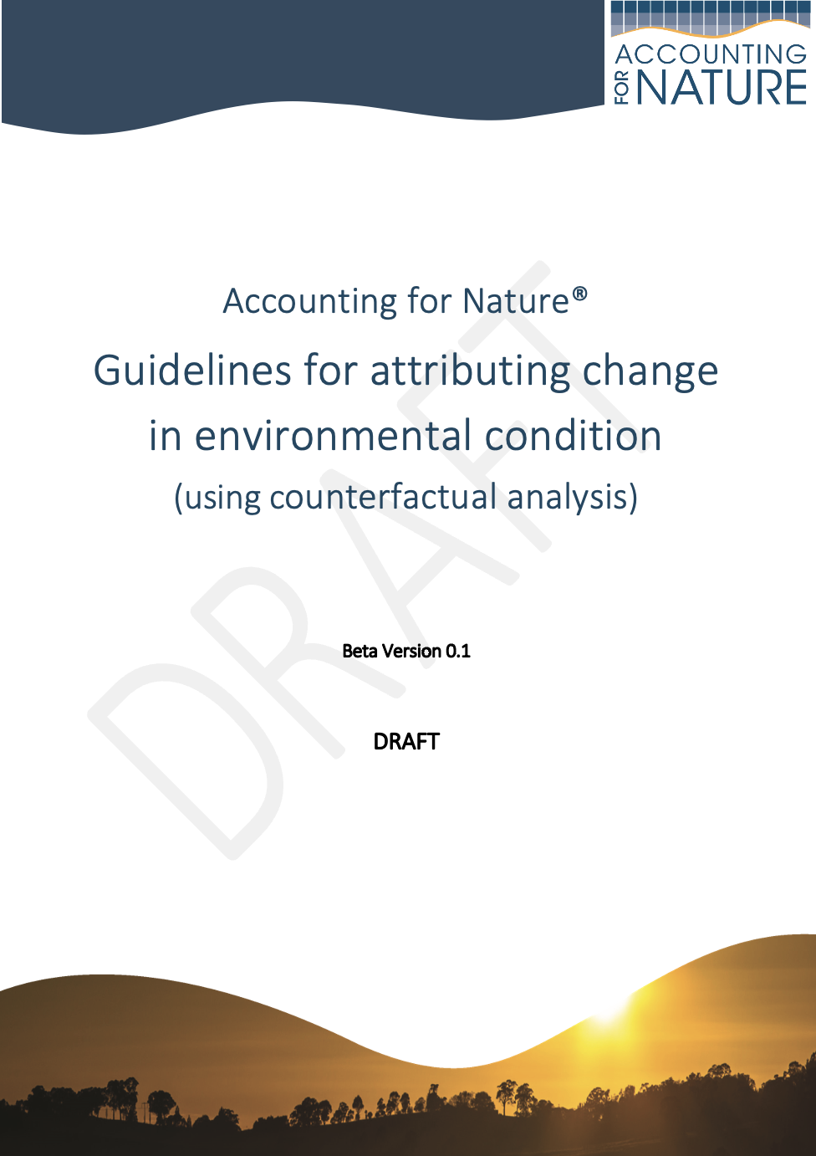
AfN Counterfactual Guidelines
Key Points
If a Proponent wants to make a public claim about the outcomes of a specific management impact or intervention, then they require counterfactual analysis to substantiate and have confidence in the claim.
Counterfactual Analysis can be used to underpin the additionality requirements of nature credits.
How to establish cause and effect
Physical control areas
Scenario modelling

Slide 28
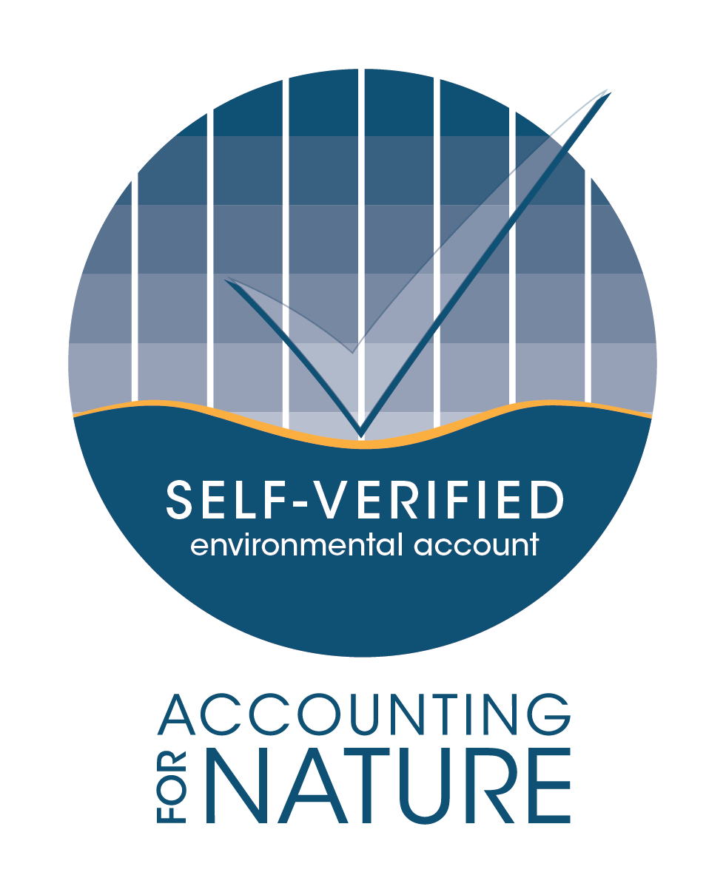
AfN Environmental Account Certification process
1. DESIGN
Define the purpose & scope of the account Identify and prioritise environmental asset(s) Select existing or create new Method(s) Use Method(s) to plan stratification, indicators & Reference Benchmarks
2. REGISTER
Register project with Accounting for Nature Ltd
3. BUILD
Collect data Calculate Econd®
4. SUBMIT
Prepare account documentation, including Environmental Account Summary & Information Statement Obtain Technical Assessment or independent audit Set Condition Targets (optional)
Submit for “Self-Assessed” or “Certification” license approval
5. MAINTAIN
Maintain active project registration Submit Annual Certification Compliance Report Submit account and audit report (minimum every 5 years)
Repeat steps 3 - 5

Slide 29
What do I need to become certified?
Environmental Account
Information Statement
Verification Report
Statement of Compliance & Good Faith
Spreadsheets and supporting documents
Documents the process of creating the Environmental Account
Statement in a form approved by AfN
Independent audit report or Self-verification with an AfN Technical Assessment required every 5 years

Slide 30
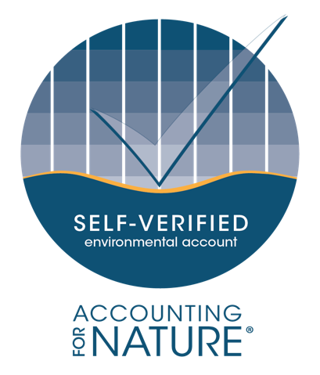
AfN Certification Options
TIER 1
For those landholders/ organisations that want a trust mark to credibly engage in environmental markets, including: public & private finance (impact investment, carbon-co-benefits, performance grants), consumer products e.g. food & fibre.
Independent third-party verification required.
TIER 2
For small landholders and others who are not ready / have the budget for independent auditing but that want some recognition of their efforts in environmental accounting and/or to inform better land management.
Self-verification & AfN Technical Assessment required.
Not for general distribuion

Slide 31
Fee Schedule
The purpose of AfN’s two-tiered certification system is to provide options to the market to suit a range of budgets.
It provides a pathway for organisations who are not immediately ready to achieve full certification to be recognised for their participation as they progress on their environmental accounting journey.
https://www.accountingfornature.org/key-documents

Slide 32
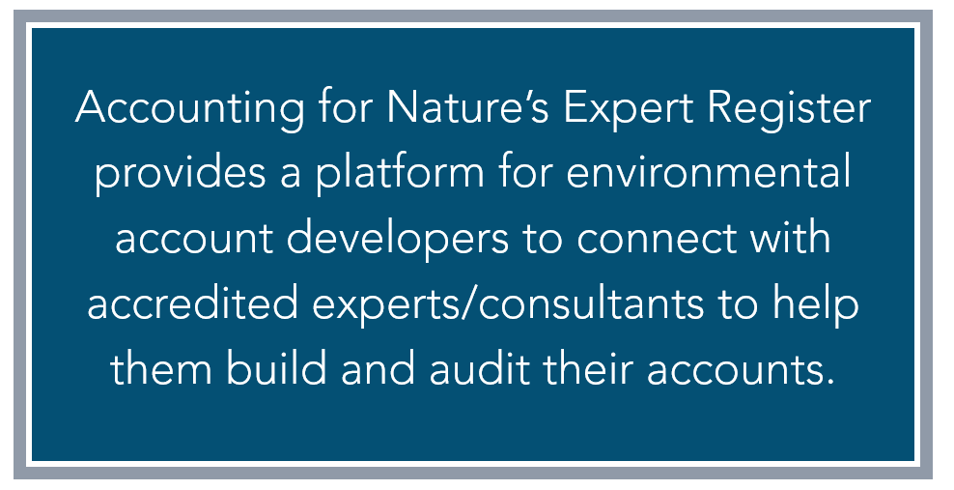
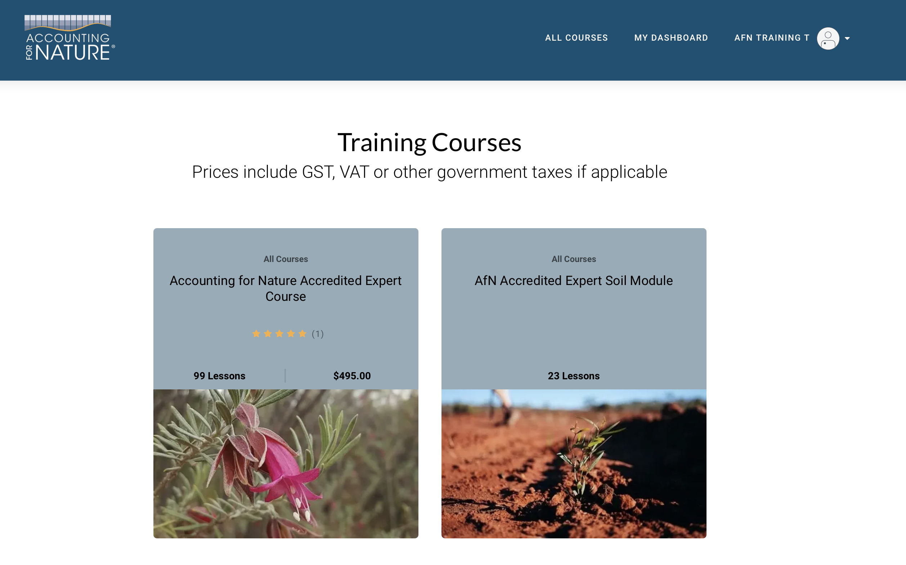
Online training & assessment system
To be accredited, you need to complete the AfN Accredited Expert Course and meet the qualification pre-requisites
https://accountingfornature-training.thinkific.com/

Slide 33
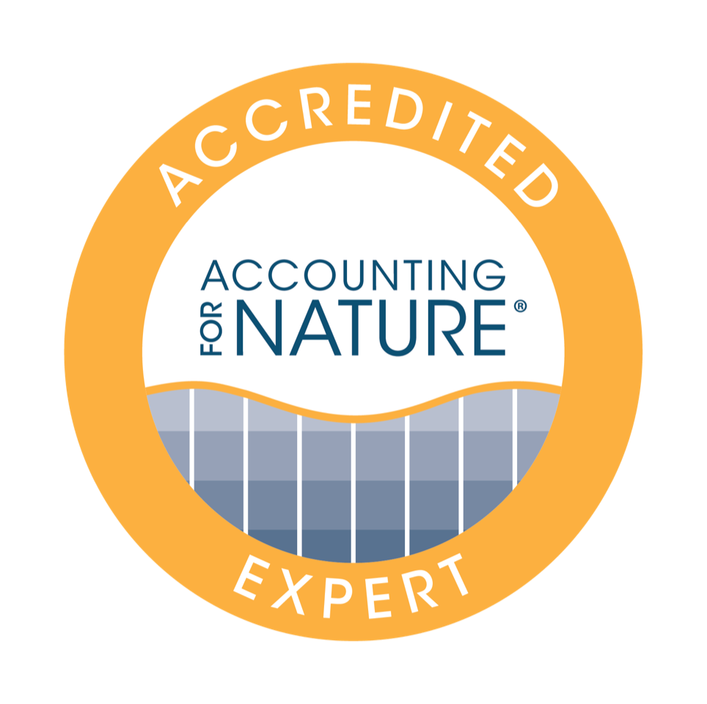
AfN ACCREDITED EXPERTS
Experts who help with Account development
Category 1
Technical/Scientific Experts
Category 1 experts have demonstrated applied scientific expertise. Category 1 Experts must nominate their area of specialisation (e.g. “native vegetation”, “fauna”, “soil” etc). In addition to their scientific expertise, Category 1 Experts also have the capability to develop environmental accounts.
Category 2
Accounting/Project Experts
Category 2 experts have demonstrated experience in fields related to environmental accounting. Category 2 Experts are deemed to have the capacity to lead the development of environmental accounts, however AfN recommends that they assess whether there is a need to be supported by Category 1 Experts where Methods require specialist scientific expertise for experimental design or ecological monitoring or measurement.
Proponents are encouraged, but do not have to use AfN Accredited Experts to develop environmental accounts.

Slide 34
EXPERT ACCREDITATION PATHWAYS
To become an AfN Accredited Expert, all applicants must complete the AfN Accredited Expert Training Course and pass the online assessment modules.
To become accredited as a Category 1 or Category 2 Expert, applicants must satisfy the following eligibility requirements:
Relevant vocational or tertiary-level qualifications in natural sciences, environment, sustainability management or other related disciplines; and
A minimum of 3 years work experience in a related field
Special application provisions for those with “other relevant skills and experience - if the applicant has a background in applying financial, environmental or carbon accounting (for example) other than described above, applicants can contact AfN to assess their eligibility to be accredited as an Expert before undertaking the AfN Accredited Expert Course.

Slide 35
AfN ACCREDITED AUDITORS
Auditors who independently verify Accounts
AfN Accredited Auditors
AfN Accredited Auditors are experienced auditors who possess the skills to audit and assure the rigour and accuracy of certified Environmental Accounts. To become accredited as an AfN Auditor, applicants must pass additional eligibility requirements.
An AfN Accredited Auditor must be engaged by a proponent for the purposes of certifying an environmental account for Tier 1 Certification.
Not for general distribution

Slide 36
EXPERT ACCREDITATION PATHWAYS
To become an AfN Accredited Auditor, all applicants must complete the AfN Accredited Expert Training Course and pass the online assessment modules. Click here to access the training portal. In addition, applicants must satisfy the following requirements:
a) Relevant tertiary-level qualifications (e.g. accounting, finance etc);
b) minimum experience in preparing audits (1000 hours);
c) demonstrated audit, assurance, and audit team leadership experience; and
d) knowledge of the AfN Framework and account development process.
The fee to become accredited as an Expert is $300 per new registration. The ongoing annual fee once accredited is $150 for all Experts.
https://www.accountingfornature.org/accredited-experts

Slide 37
Interested in developing an Environmental Account?
Sign up to the AfN Training Portal and complete the free preview https://accountingfornature-training.thinkific.com
Steps to start the Account development process
Contact an AfN Accredited Expert to assist with the account development process
https://www.accountingfornature.org/cat-1-2-expert-register
Decide on the tier of certification best suited for your circumstances, and submit your Environmental Account for Auditing or an AfN Technical Assessment
Not for general distribution

Slide 38
Questions?

